Slide 1
Sequence to Sequence Learning
with Neural Networks
Sutskever, Vinyals & Le — NeurIPS 2014
Problem • Encoder–Decoder • Seq2Seq Learning • Results • Applications • Strengths & Limitations

Slide 2
MOTIVATION
Problem Statement
DNNs need fixed-size input/output
Standard deep nets map a fixed-size vector to a fixed-size vector — they can't handle sequences of unknown, varying length.
Many real tasks are sequence-to-sequence
Translation, speech recognition, question answering — input and output lengths differ and aren't known in advance.
Goal
Learn a general, end-to-end mapping from one sequence to another, with minimal assumptions about structure.
2

Slide 3
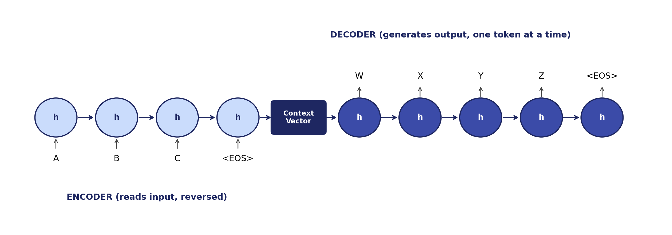
CORE IDEA
Encoder–Decoder Architecture
One LSTM (encoder) reads the input and compresses it into a fixed-size context vector; a second LSTM (decoder) generates the output sequence from that vector, one token at a time.
3

Slide 4
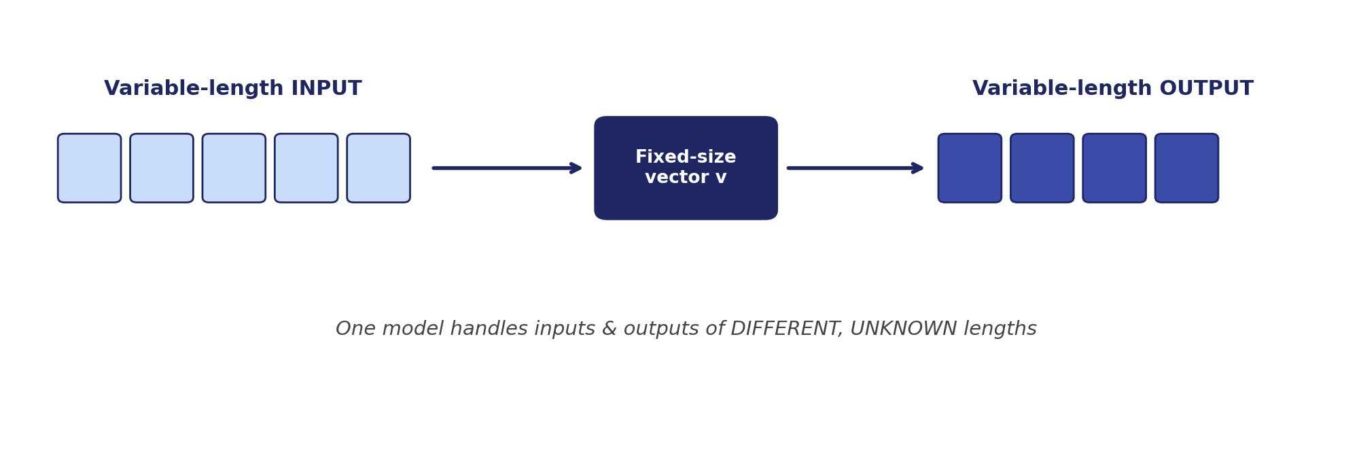
HOW IT WORKS
Sequence-to-Sequence Learning
• 4-layer deep LSTMs, 1000 cells/layer, 1000-dim word embeddings
• Trained to maximize log-probability of the correct target sequence
• Key trick: reversing the source sentence — shortens dependencies, eases optimization
• Left-to-right beam search used to generate translations at inference time
4

Slide 5
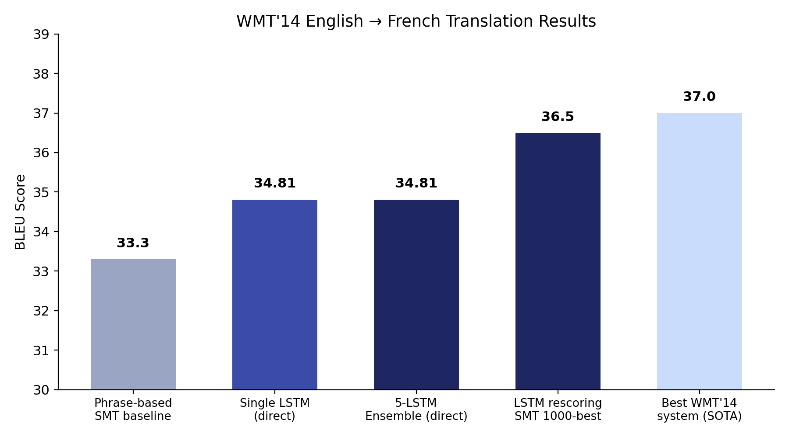
WMT'14 EN→FR TRANSLATION
Experimental Results
5

Slide 6
WHERE SEQ2SEQ IS USED
Applications
Machine Translation
Speech Recognition
Text Summarization
The original task — English–French, now the base of modern NMT systems
Audio frames → text transcripts
Long document → short summary
Conversational AI
Image Captioning
Code Generation
Chatbots, dialogue generation, question answering
CNN features → caption sequence (paired with a decoder LSTM)
Natural-language description → code sequence
6

Slide 7
EVALUATION
Strengths
General, end-to-end — minimal task-specific assumptions
First pure neural system to beat a phrase-based SMT baseline
Learns meaningful sentence representations (order-sensitive, voice-invariant)
Handles long sentences well after the input-reversal trick
Deep LSTMs generalize better than shallow ones (perplexity improves per layer)
7

Slide 8
EVALUATION
Limitations
Fixed-length context vector is an information bottleneck for long sequences
No attention mechanism — later fixed by Bahdanau et al. (2015)
Very compute-heavy: 8 GPUs, ~10 days of training for one model
Ensembling (5 LSTMs) needed to reach best reported score
Vocabulary capped at 80k–160k words — penalized on out-of-vocabulary tokens
8

Slide 9
LEGACY
Why This Paper Matters
Founded modern NMT established the encoder–decoder paradigm still used today
Inspired attention its bottleneck motivated Bahdanau et al.'s attention mechanism
Precursor to Transformers "Attention Is All You Need" (2017) builds directly on this line of work
9

